Slide 1
Partial Label Continual Learning
Presented by
Kevin Zheng
Supervised by
Dr. Tongliang Liu
Faculty of Engineering
Notes:
Good afternoon, professors, doctors and audiences. I’m Kevin. In today’s presentation, I’m gonna talk about partial label continual learning.

Slide 3
Outline
Background
Machine Learning
Continual Learning
Partial Label Learning
Research Question
Aims
Methods
Results
Discussion & Conclusions
Notes:
This presentation is gonna dived into three parts. First, I’ll give you some basic information about my research area. Then I’ll move into my research in this project, and give you more details about the aims, methodology, and results. Finally, I’ll provide a conclusion and discuss future work.

Slide 4
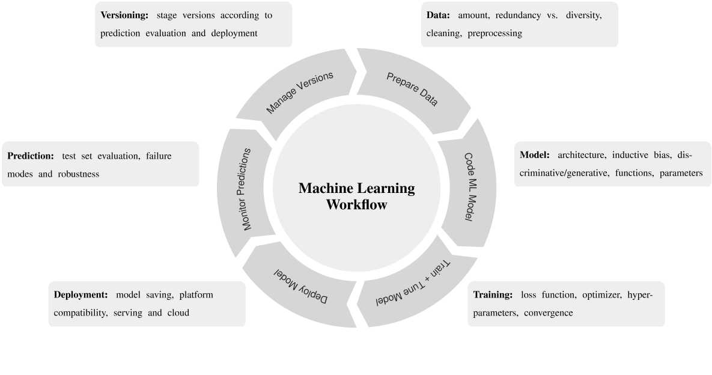
Background – Machine Learning
“A computer program is said to learn from experience E with respect to some class of tasks T and performance measure P, if its performance at tasks in T, as measured by P, improves with experience E”.
Machine Learning, T. M. Mitchell, McGraw-Hill,1997
Mundt et al, “CLEVA-Compass: A Continual Learning Evaluation Assessment Compass to Promote Research Transparency and Comparability”, ICLR 2022
Notes:
Ok, so what is machine learning? As a human, we all know the human learning process is trying to expose to some new stuff. When we interact with those new stuff, we can learn some new skills or experiences, and those experiences can also help us to learn other knowledge efficiently. As we were a child, when we saw a dog, our mum will tell us “this is a dog”, when we saw a cat, our mum tell us “this is a cat”. It might be hard for us to tell them apart at first because they were both furry. But when we saw the cat and dog many times, and each time mum would tell us the right answer. We then learned how to classify cats and dogs. In fact, machines can do exactly the same thing, a program can learn some useful knowledge or experience from the data for a specific task, and this experience can also improve the performance in that task. Some classic computer vision machine learning task includes

Slide 5
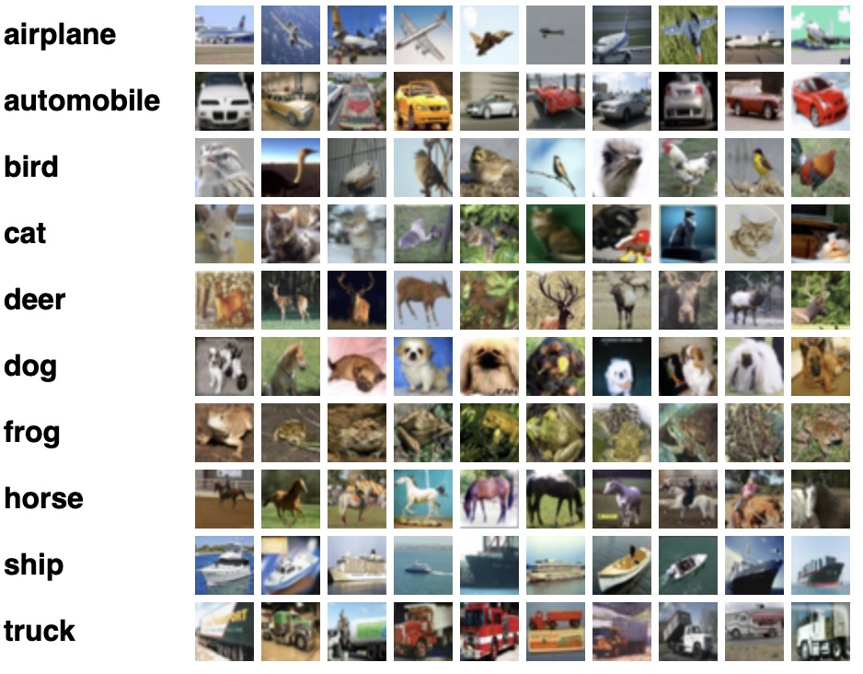
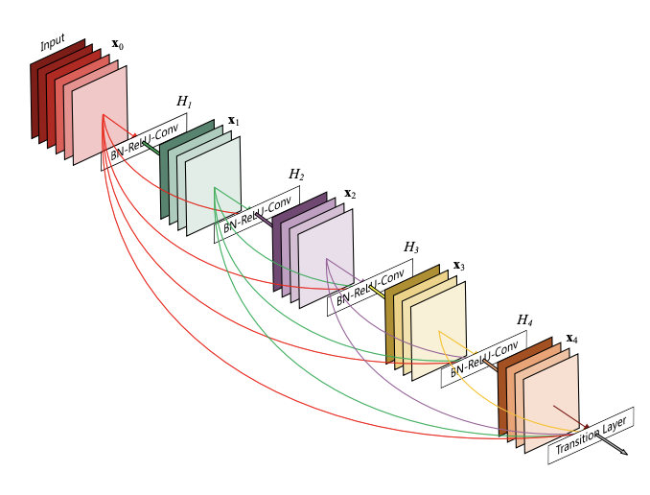
Computer Vision – Image Classification
CIFAR-10 and CIFAR-100 Datasets, https://www.cs.toronto.edu/~kriz/cifar.html.
Gao Huang et al. “Densely Connected Convolutional Networks” computer vision and pattern recognition (2016): n. pag.
Notes:
Image classification. When you give the model an image, it’ll you what it is

Slide 6
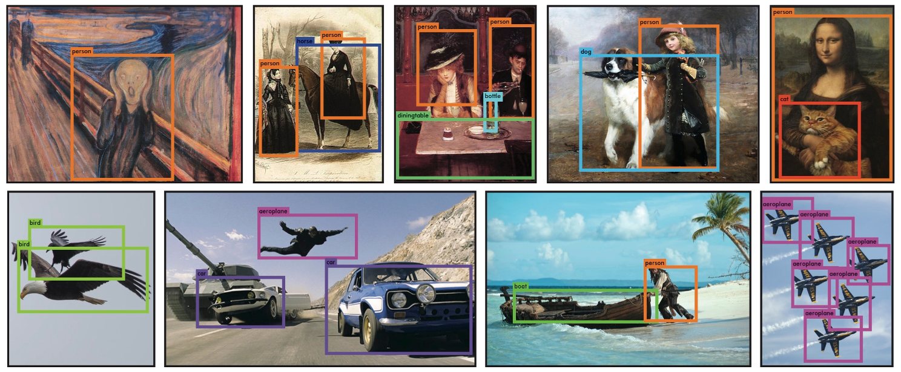
Computer Vision – Object Detection
Joseph Redmon et al. “You Only Look Once: Unified, Real-Time Object Detection” computer vision and pattern recognition (2016): n. pag.
Notes:
Object detection. When you give the model an image, it’ll detect what object is in the image, and box them.

Slide 7
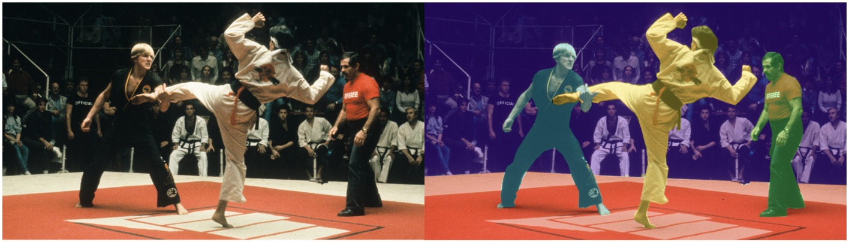
Computer Vision – Semantic Segmentation
Sanchez-Lengeling, Benjamin, et al. “A Gentle Introduction to Graph Neural Networks.” Distill, 8 Sept. 2021, https://distill.pub/2021/gnn-intro/.
Notes:
Semantic Segmentation. Which is similar to object detection, but it is more precise in the pixel level

Slide 8
Computer Vision – Image Classification
CIFAR-10 and CIFAR-100 Datasets, https://www.cs.toronto.edu/~kriz/cifar.html.
Gao Huang et al. “Densely Connected Convolutional Networks” computer vision and pattern recognition (2016): n. pag.
Notes:
Today, I’ll focus more on image classification.

Slide 9
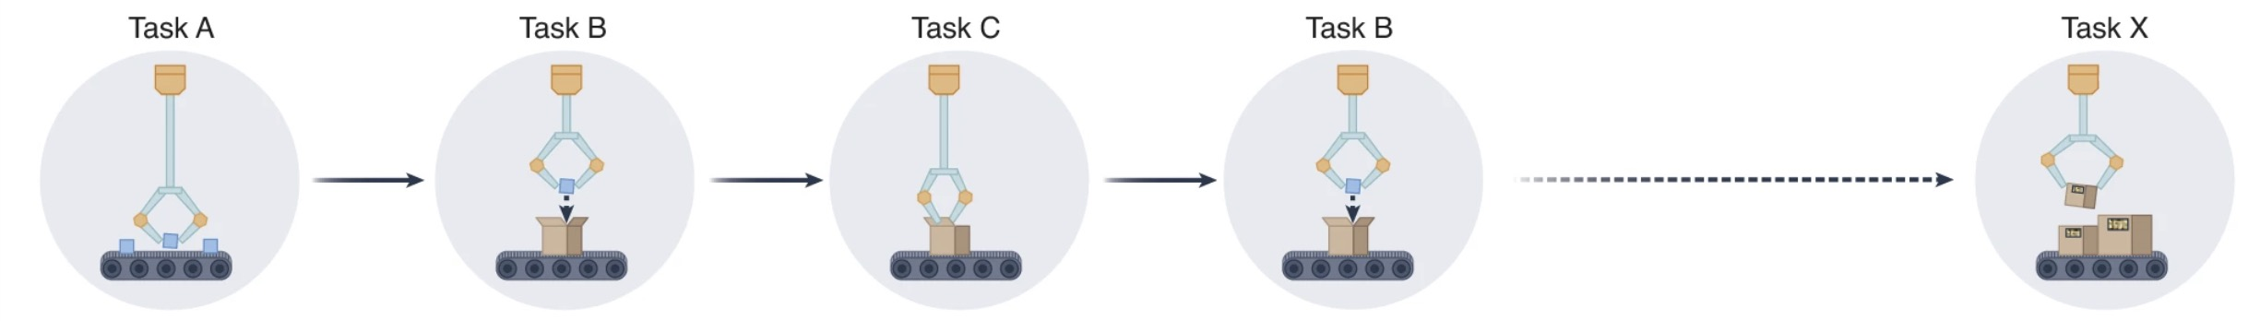
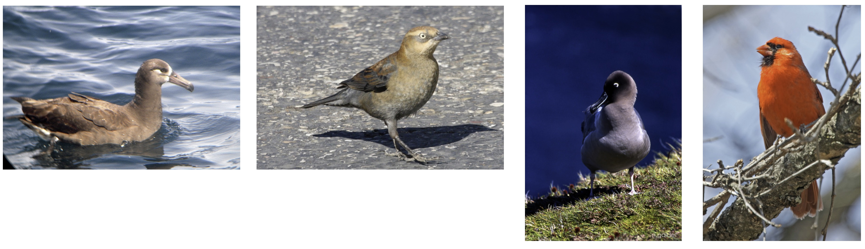
Background – Continual Learning
But what if we want to continue learning tasks or add more categories?
Kudithipudi et al, “Biological underpinnings for lifelong learning machines”, Nature Machine Intelligence (4), 2022
Image examples from CUB200: “black footed albatross”, “rusty blackbird”, “sooty albatross”, and “cardinal”. Welinder et al, Caltech-UCSD Birds 200, CNS-TR-2010-001, California Institute of Technology, 2010
Notes:
Nowadays, many state-of-the-art research is more concerned with a fixed task, like how to classify cats and dogs, so a model can only perform a particular task. But what if we want to continue learning tasks or add more categories? That’s how humans learn. Continual learning setting is trying to learn different tasks continually, or sometimes we also call it class-incremental learning. For example, we train a model to classify cats and dogs, then we want it to classify different vehicles in the same model. In fact, for either traditional image classification tasks or in the continual learning setting, we both need a lot of clean and labelled data. However, getting clean labelled data is very expensive, because it relies on manual labelling.

Slide 10
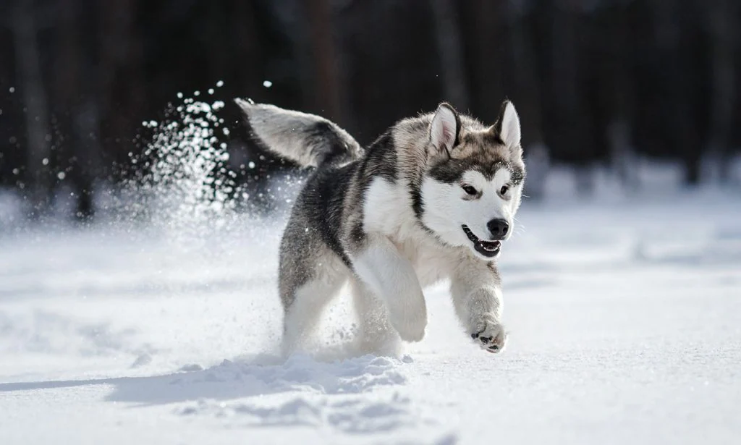
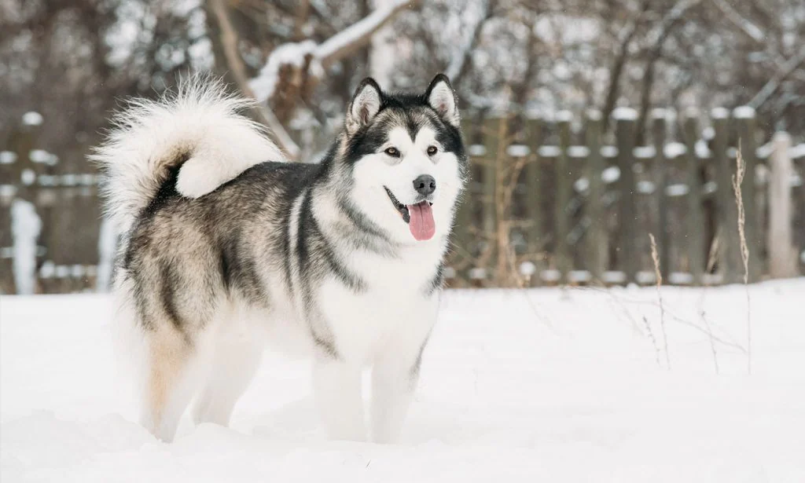
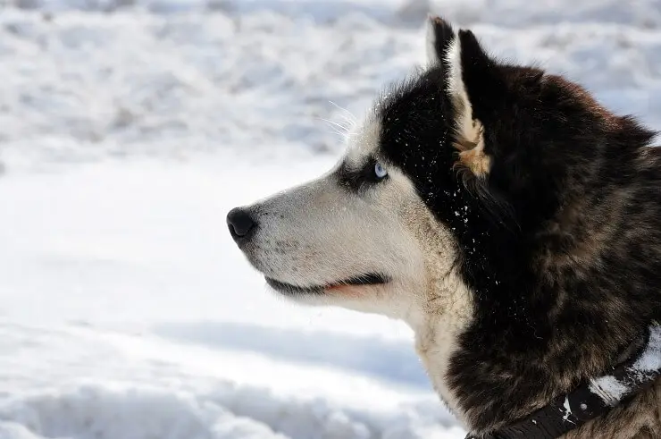
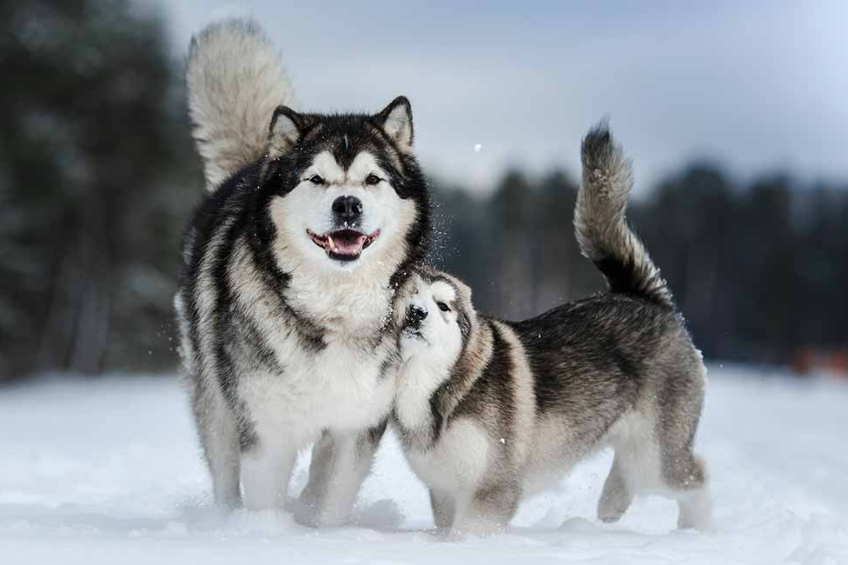
Background – Partial Label Learning
Real work label might be ambiguous
Husky
Malamute
Inuit dog
Alaska dog
Notes:
In real life, most of the data labels are quite ambiguous. For example, the slide shows 4 different dog breeds which is Husky, Malamute, Inuit dog and Alaska dog respectively. But they all look very similar. Partial label learning setting is trying to use the data with a label set instead of the fully labelled data. Which means each image has a set of labels that includes the true label inside it.

Slide 11
Aims
My research aims for higher machine intelligence through non-stationary and never-ending stream data. A more robust continual learning method is proposed by using partial labels of the weakly supervised learning method instead of the traditional fully supervised learning method.
Notes:
So I was thinking about can I combine these two deferent settings and come up with a model that is more in line with the human learning process. My research aims for higher machine intelligence through non-stationary and never-ending stream data. A more robust continual learning method is proposed by using partial labels of the weakly supervised learning method instead of the traditional fully supervised learning method. What we said “supervised” means that we need manual labelled data. To implement this model, I‘m gonna divided my method into two parts.

Slide 12
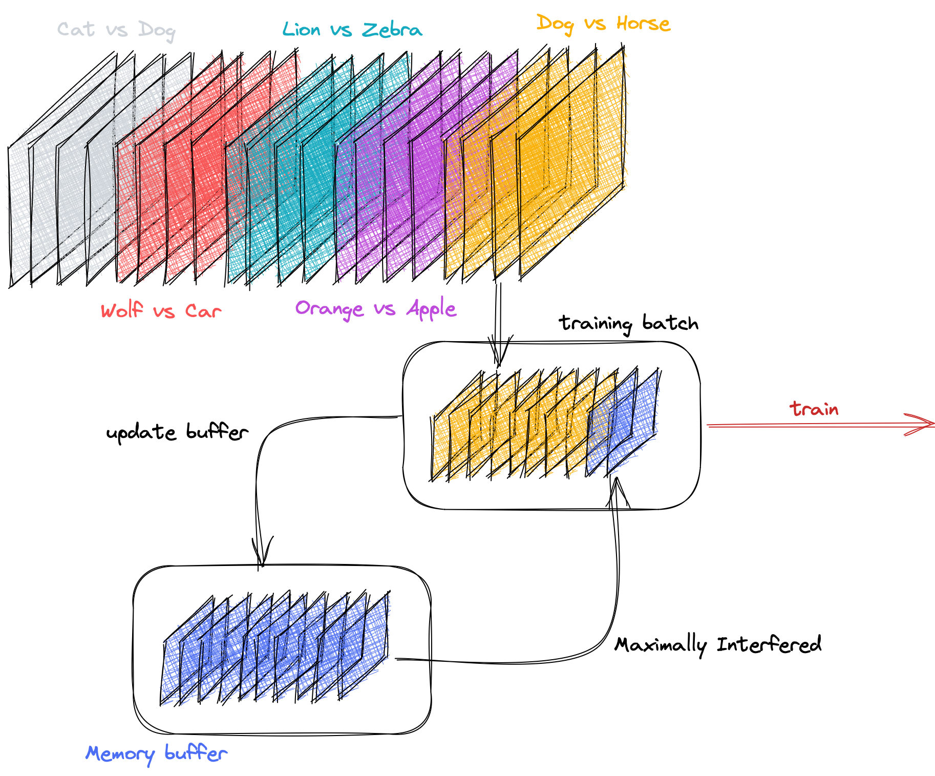
Methods
Continual Learning
Memory-based
Maximally Interfered Retrieval
Notes:
First, I’m gonna talk about the continual learning part. The most important challenge in continual learning is called catastrophic forgetting. This means the model will easy to forget the past knowledge from the old task when it learn some new knowledge from the new task. In a continual learning setting, it is common to say that when we train a new task, the samples from the old task will not be available again. Some studies have shown that storing some parts of the sample from old tasks and training them together with new tasks might help to prevent forgetting. It’s like taking notes for revision when we study, even though the notes are not that comprehensive as the original knowledge, they are still essential to prevent forgetting. Although storing data in a limited buffer might lead to class imbalance as well as data privacy issues, the memory-based method is still simple and effective. Due to the limitations of the GPU memory size, we cannot use all the data in the memory buffer, so how we select the data for review is key. In my model I select the samples that interfere the model the most for review. The reason I do this is that in revision we need to relearn the knowledges that we know the least.

Slide 13
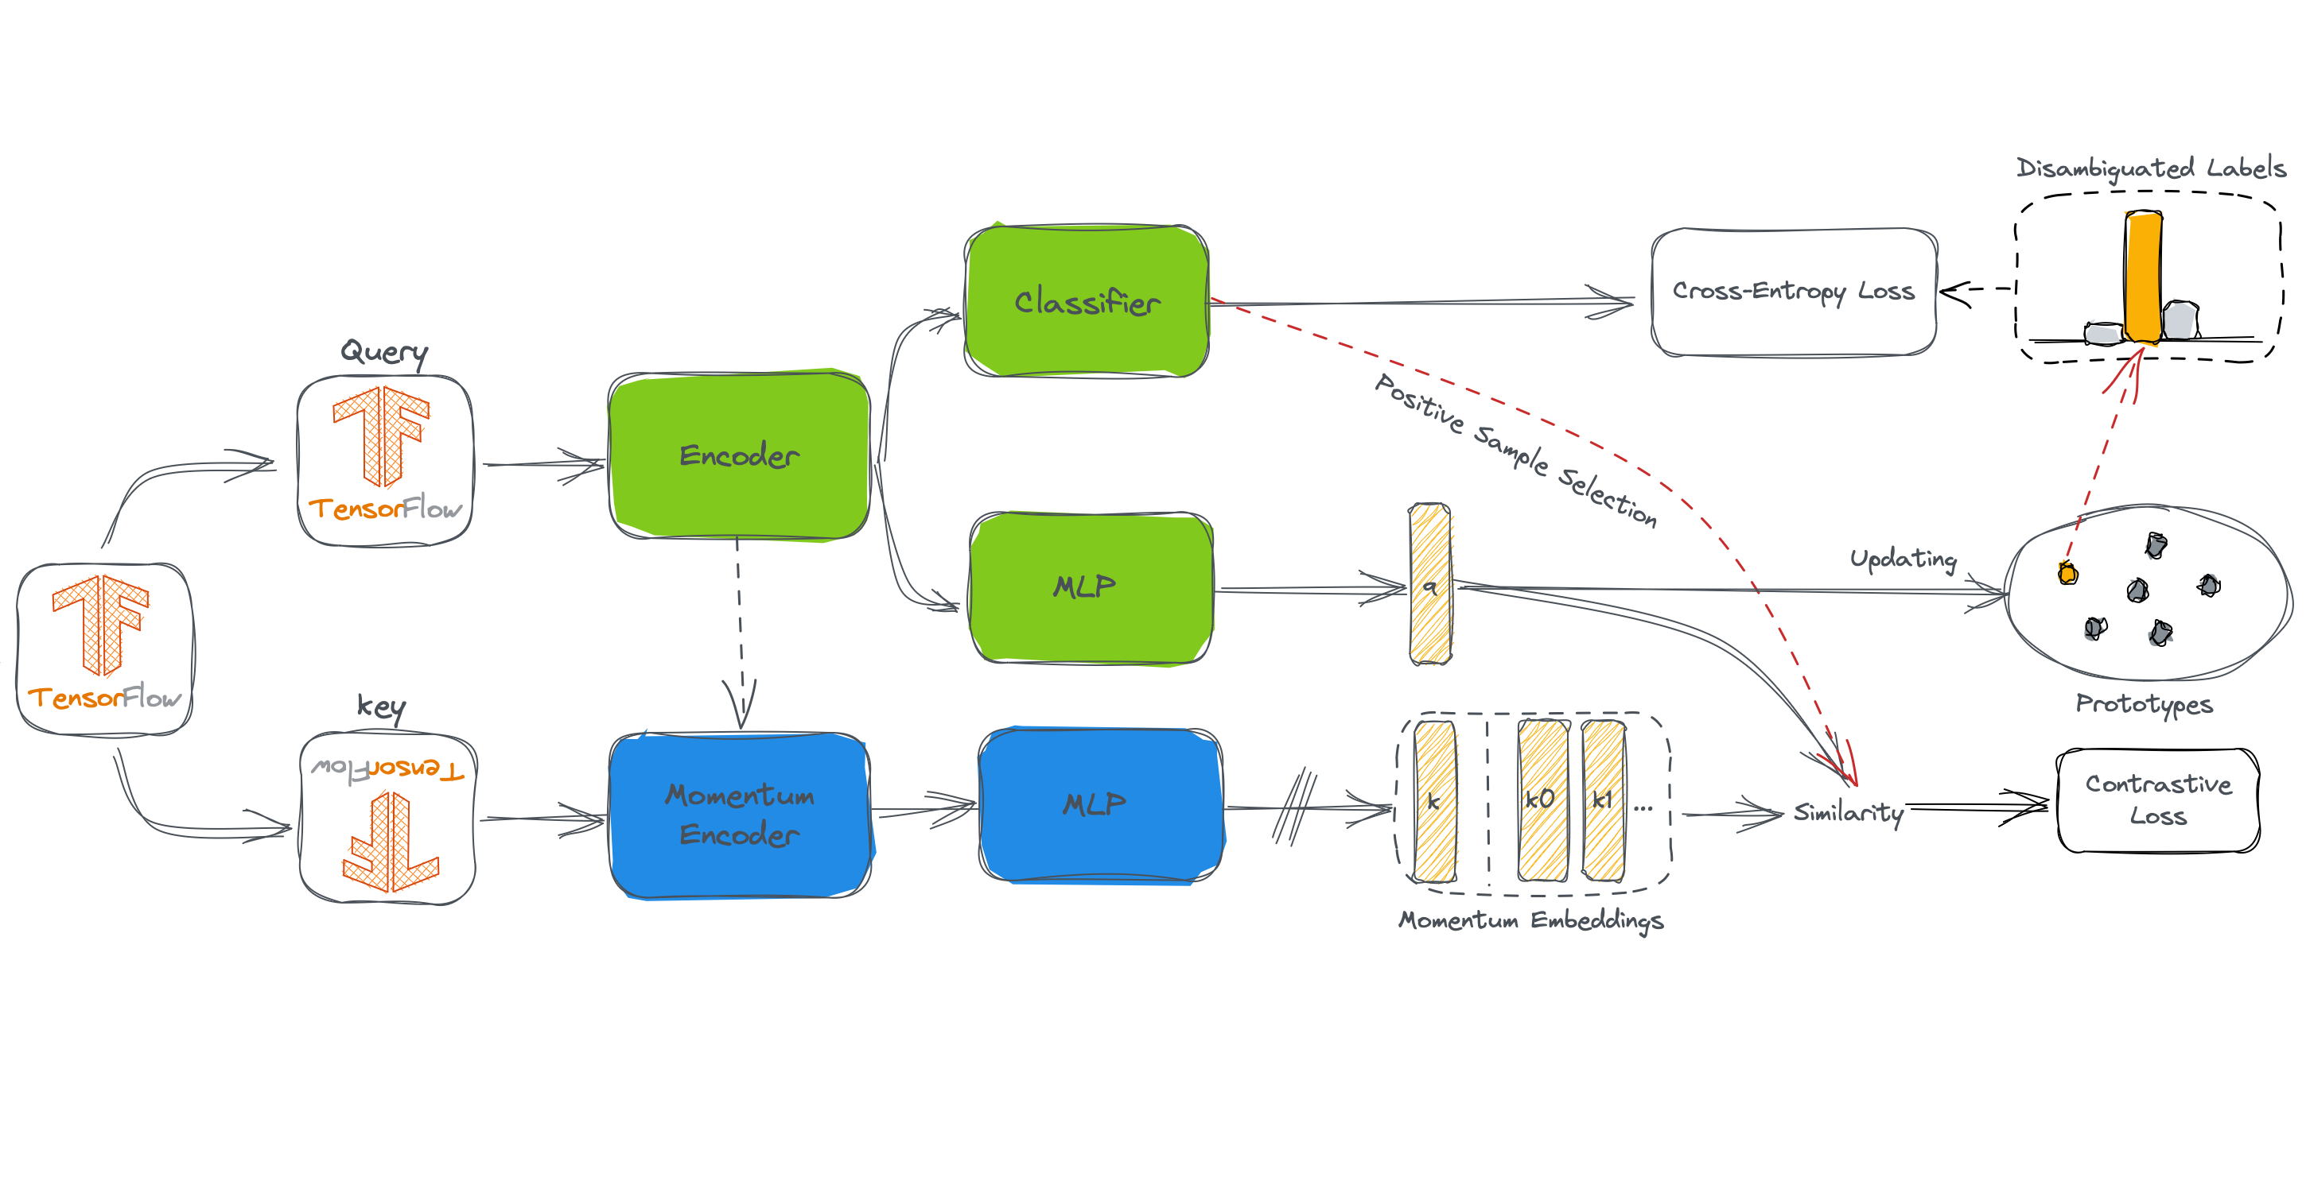
Methods
Partial label learning
Contrastive Representation Learning
Label Disambiguation
Notes:
Then I’m gonna talk about the partial label learning part that is how we training. Inspired by contrastive learning, some studies have prove that using contrastive learning representations to help label disambiguation is an effective method. Before we continue, I should give you some basic information about contrastive learning.

Slide 14
Methods – Contrastive Learning
Notes:
In Contrastive learning setting, When we give these three images on the slide to the model, we want the model to be able to distinguish that these two pumpkins belonging to the same category and the ghost is not, but we don't need to know exactly what each category is. In this way the model can learn something useful to distinguish between the different images.

Slide 15
Methods
Partial label learning
Contrastive Representation Learning
Label Disambiguation
Notes:
Okay, let’s back to partial label learning. The knowledge we learn through contrastive learning can help with label disambiguation, that is selecting the correct label in each sample‘s label set. In turn, the more accurate the model predicts the labels, the better the representation can be for contrastive learning. Then, Let’s just have look some of the results of this model.

Slide 16
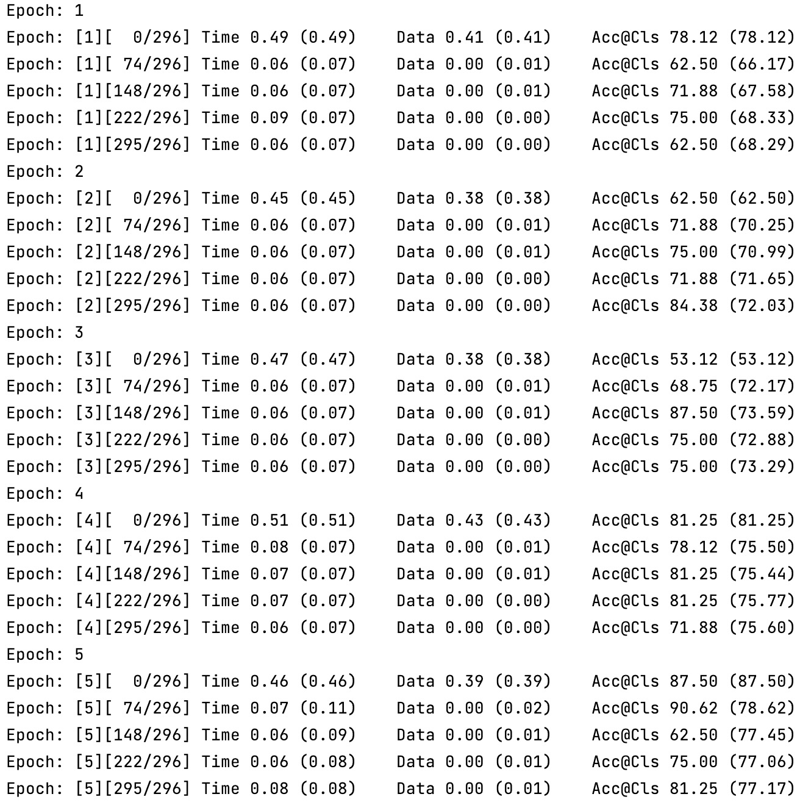
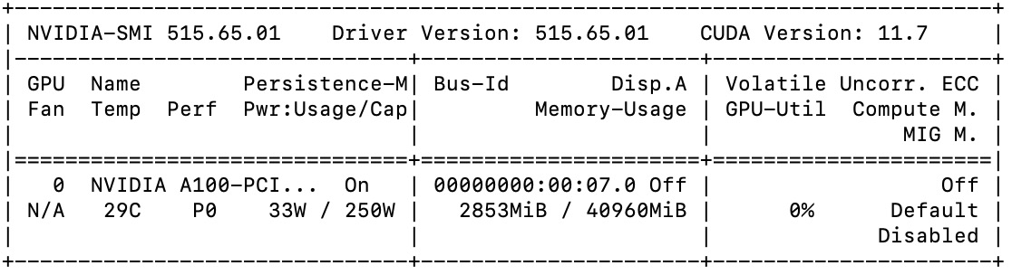
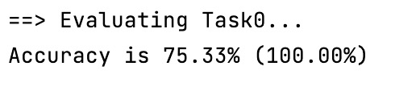
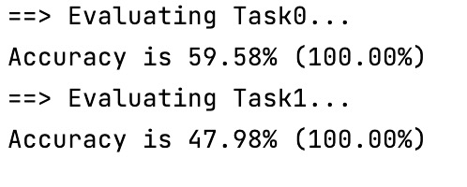
Results
Notes:
It is important to note that my experiment is not over yet, but we can observe some trends in the data so far. This experiment was run for 50 epochs under each task using the Nvidia A100. The experiment showed that the average accuracy of the contrastive learning model did increase significantly under each task. The degree of forgetting of the model on the old task after continuous learning a new task was also comparable to that of a fully supervised continual learning method. However, this experiment are unacceptable for 2 tasks trained for 3 hours under A100. I think that the main reasons for this are probably the model parameters are not optimal and the model converges slowly due to the partial labels. Finally, let’s move on to the conclusions.

Slide 17
Discussion & Conclusions
My work
Propose the partial label continual learning
Future work
Optimize the model parameters
Testing new ideas
Extended to other computer vision task
Notes:
In my work, I propose a partial label continual learning method. It is based on a memory-based continual learning method, using the degree of sample interference with the model as a selection criterion. The model is inspired by contrastive learning and uses contrastive learning as a representational network to help label disambiguation. Experimental results demonstrate that my method trends well in a class-incremental partial label continual learning setting. In future work, I will tune the model parameters and consider whether I can embed an importance weight to all samples to control the addition and removal of memory buffer. In addition I believe this work can be extended to other computer vision tasks as well. And this is the end of my presentation, if you have any questions you can ask right now. Thanks

